Slide 1
DESIGN OF TRIPLE EFFECT EVAPORATORS
Varshni A - 119010097
Savitha k - 119010075
Shivapriya s - 119010083

Slide 2
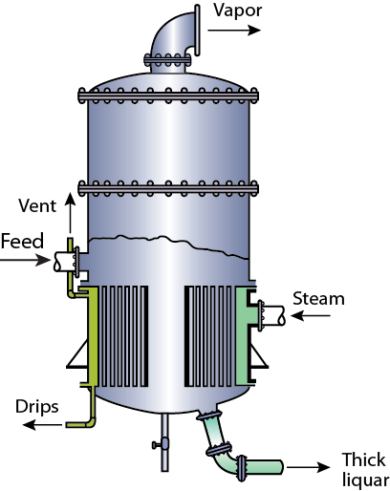
What is an Evaporator
An Evaporator is a heat and mass transfer equipment used to concentrate a solution.
Evaporators use saturated steam to vaporize the solvent in the feed thereby concentrating the feed solution.

Slide 3
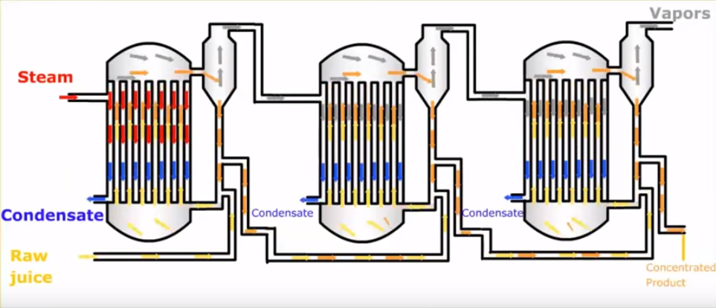
Triple effect evaporator

Slide 4
Design of an Evaporator
Variables determining the design include feed flow rate, inlet temperature of the feed, number of effects, overall heat transfer coefficient and heat transfer area of each effect.
Find the energy balance equation across each effect
Solve the equations and find the mass flow rate of vapour phase at each effect
Then calculate the heat transfer area required for the corresponding heat transfer rate obtained
If the error percentage is less than 10%,continue with the design else iterate the whole process until the design criteria is satisfied.

Slide 5
AIM
To calculate heat transfer area at each effect for designing a Triple effect evaporator for a given feed flow rate, feed temperature, and overall heat transfer coefficients.

Slide 6
ASSUMPTIONS
An ideal evaporator is considered
Mass of saturated steam at inlet is equal to the vapor obtained at the end of the operation (V=S)
Concentration of solute in vapor is negligible
Change in feed temperature due to boiling point elevation is negligible
The evaporator is operated in forward flow mode

Slide 7
PSEUDO CODE
1. Get input values of feed flow rate, feed temperature at entry, concentration of solute in feed at entry and exit, Temperature of saturated steam, Temperature of vapor at third effect, Average specific heat capacity, overall heat transfer coefficients at each effect and enthalpy of saturated steam
2. Create an object for class input_data and pass the above values to the respective class variables using a constructor.
3.Create a method find_constant inside the class to determine the sum of reciprocals of the three given heat transfer coefficients, and then multiply the sum with the difference between saturation temperature and temperature at third effect.
4.Write a method find_tempenthal to determine the temperatures T1 and T2 and correspondingly get the specific enthalpies
5.Write a function find_P to determine the product flow rate and subsequently determine (F-P).
6.Create a function solv_eqn to solve the formed linear equations by numpy.
7.Create determine _area,determine_error

